Slide 1





Mini Portfolio Project for Bootcamp Digital Skill Fair 35.0 - Data Science
Breast Cancer Classification Using Machine Learning: A Comparative Analysis of Logistic Regression, Random Forest, and Support Vector Machine
Devi Andini Sastro

Slide 2


Table Of Content
01.
02.
03.
04.
05.
06.
About Me
About the Project
Project Goals and Flowchart
Tools Used
Import Libraries and Load Data
Data Preprocessing
07.
08.
09.
10.
11.
Exploratory Data Analysis (EDA)
Train the Models
Predict and Evaluate Models
Data Visualization
Conclusion

Slide 3

About Me
Devi Andini Sastro
An enthusiastic Information Systems student, driven by a love for technology and innovation. I am particularly interested in Data Science, Web Development, and UI/UX Design, where I strive to continuously enhance my skills and knowledge.
My ambition is to bridge the gap between theory and practice, contributing to meaningful solutions that address real-world challenges in the tech industry.

Slide 4


About the Project
Project
Dataset
This project aims to build a machine learning models to predict whether a tumor is malignant or benign based on the Breast Cancer dataset.
The dataset used is the Breast Cancer Wisconsin Diagnostic Dataset from scikit-learn, containing 569 samples with 30 features.
Various classification algorithms are tested, including Logistic Regression, Random Forest, and Support Vector Machine (SVM).

Slide 5
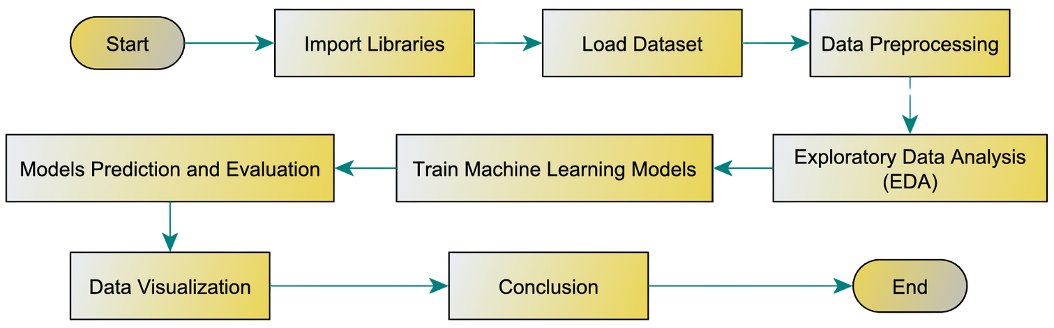
Project Goals and Flowchart
Goals:
Accurately classify breast cancer tumors as Malignant or Benign.
To develop and compare the performance of three machine learning models (Logistic Regression, Random Forest, and SVM) for breast cancer classification.
Understand key features that influence the classification decision.

Slide 6




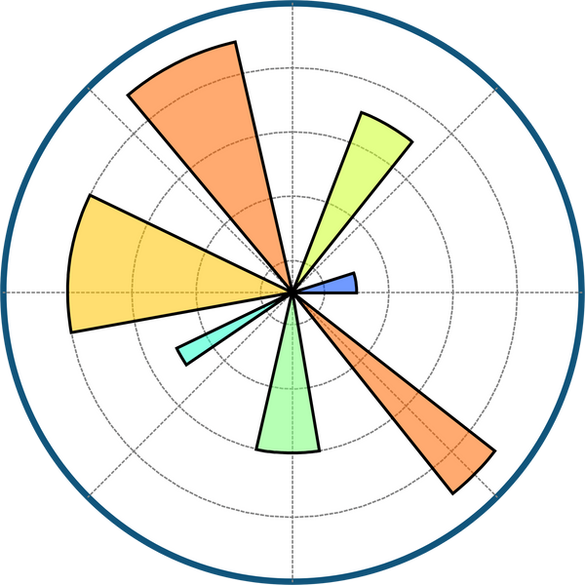

Tools Used

Slide 7
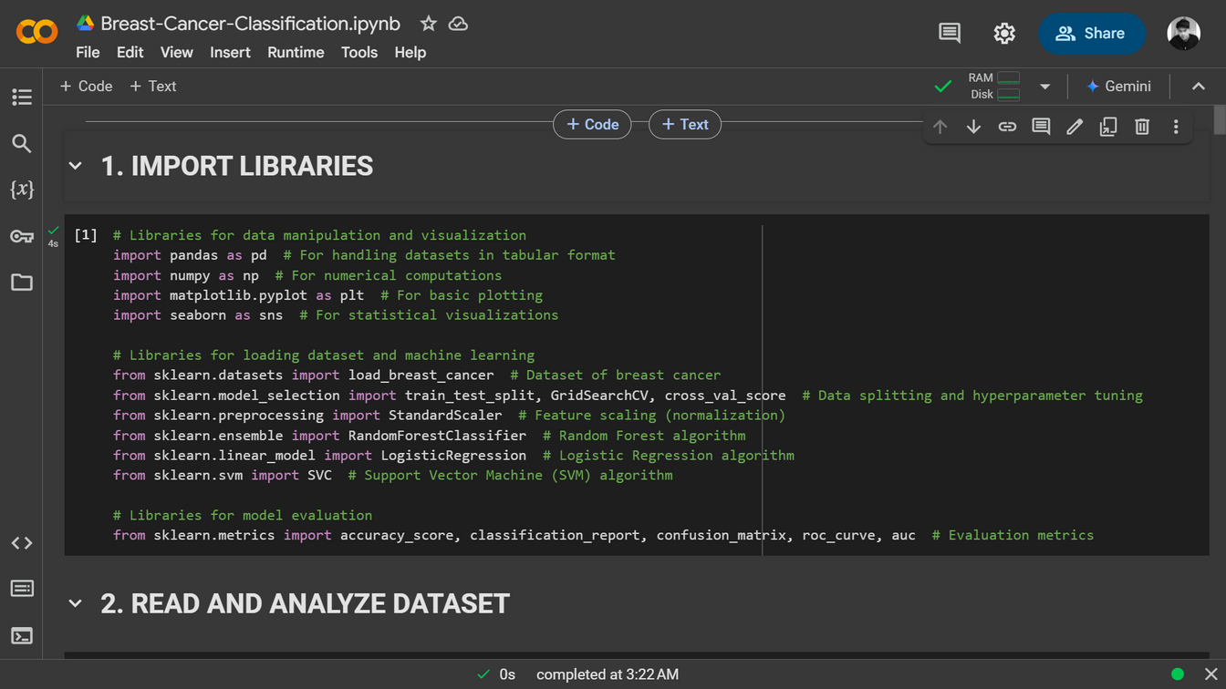
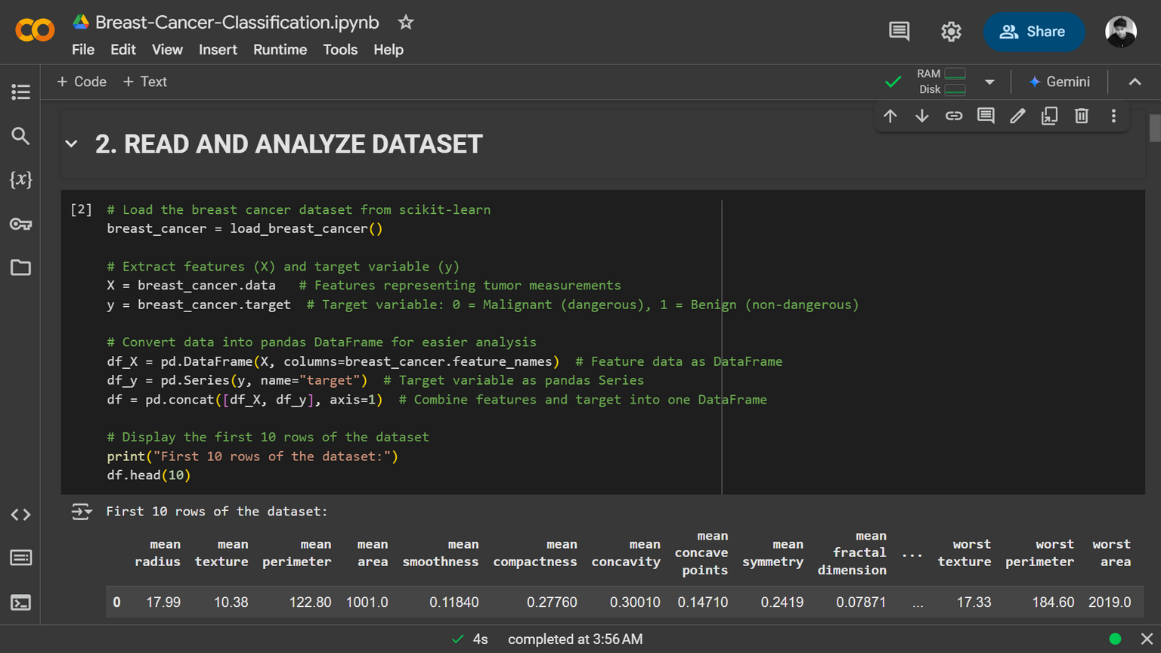
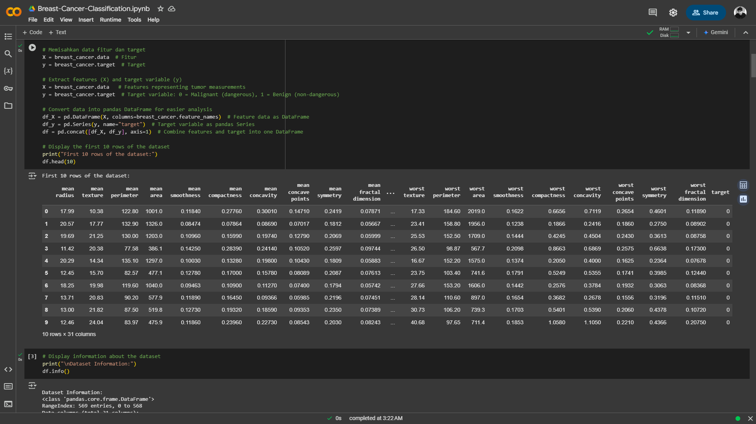
Import Libraries
Load Dataset

Slide 8
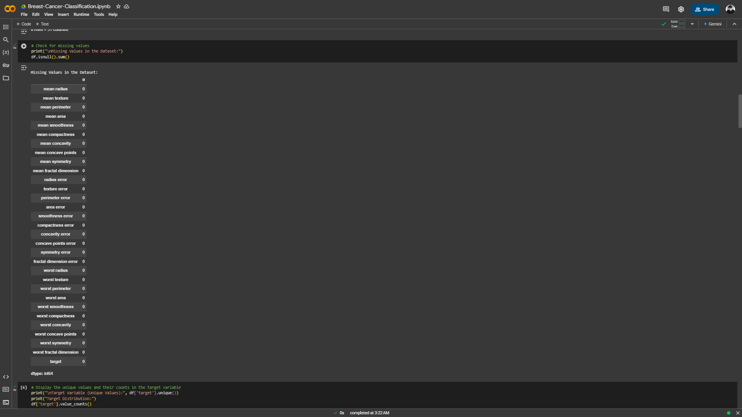
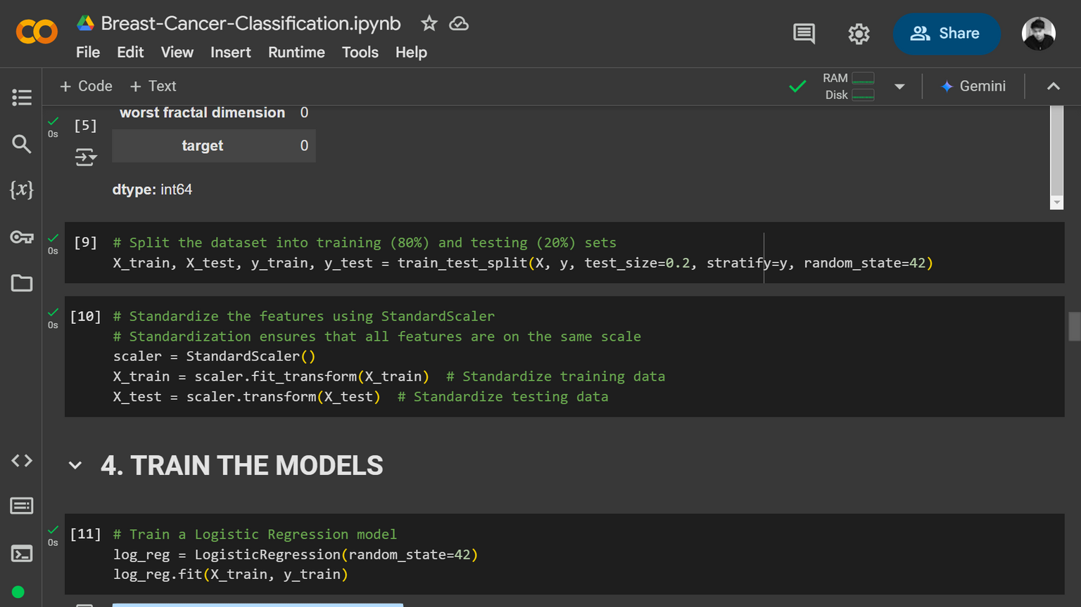

Data Preprocessing
Split Dataset
Check for missing values
Before processing, we check for missing values. Since there are none, the dataset is ready for further steps.
The dataset is split into 80% for training and 20% for testing using train_test_split(), ensuring class distribution remains balanced.
Standardization
StandardScaler() is used to normalize feature values, ensuring all features are on the same scale. This improves model performance and training efficiency.

Slide 9
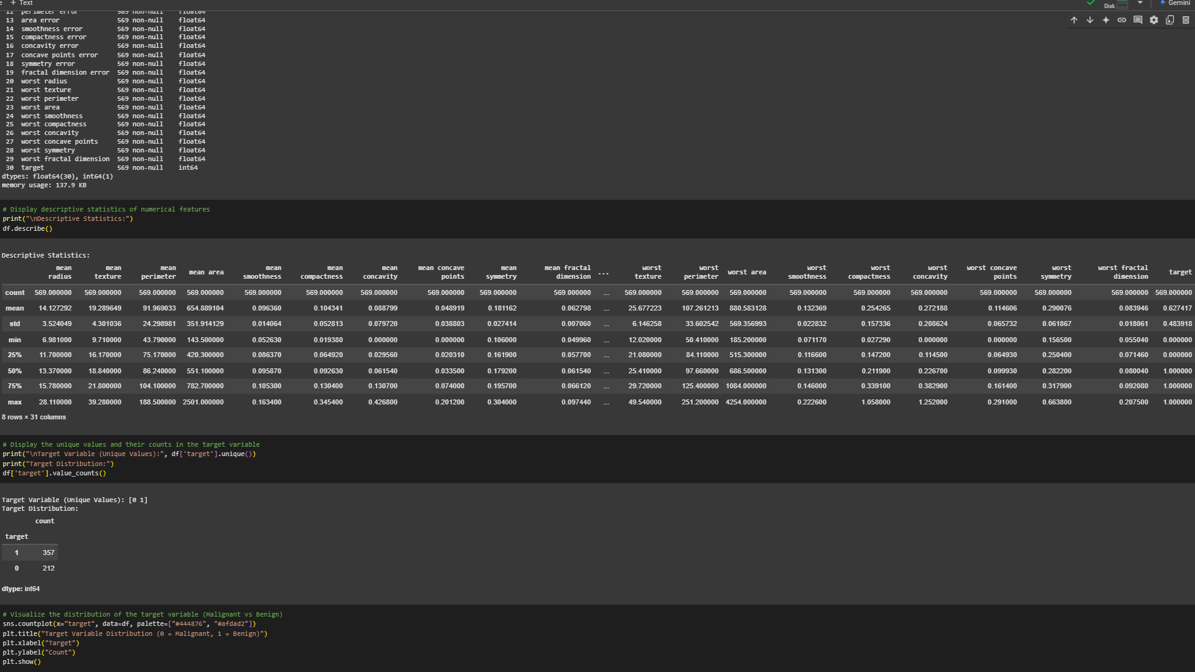
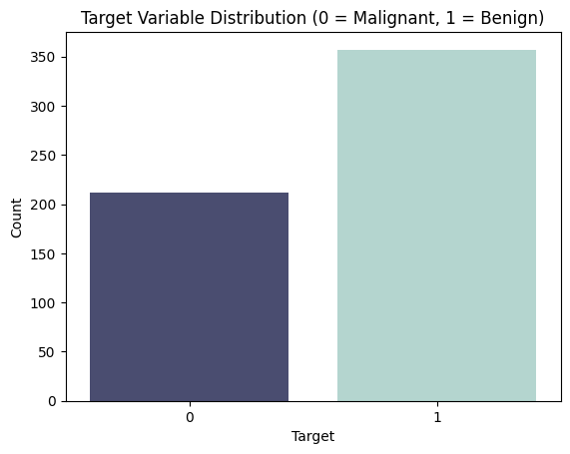
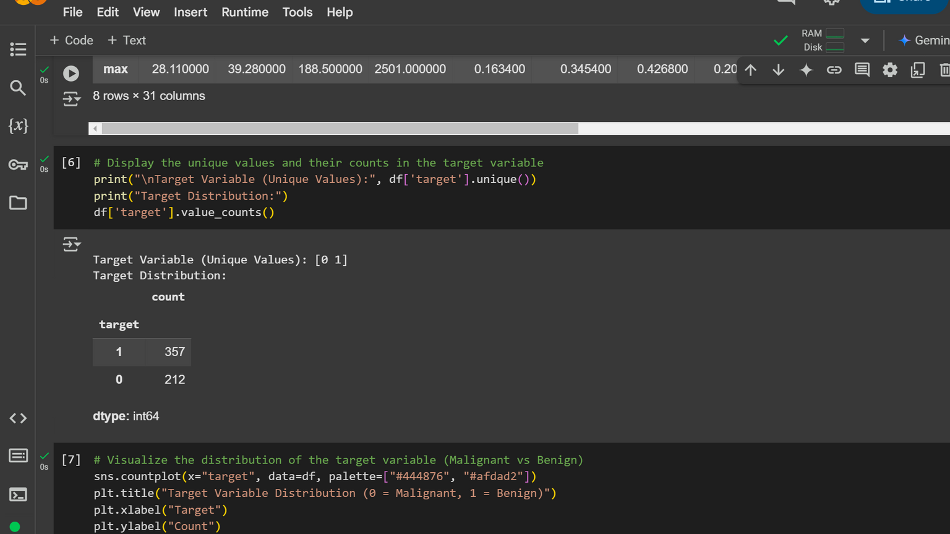
Exploratory Data Analysis (EDA)
Descriptive Statistics of Numerical Features
The table above summarizes the descriptive statistics for all numerical features in the dataset. This information is crucial for identifying outliers, understanding data spread, and preparing the data for machine learning models.
Target Variable Distribution: Malignant vs. Benign
This visualization helps in understanding the dataset composition, showing that there are more benign cases than malignant cases. This distribution provides valuable insights for further analysis and model training

Slide 10
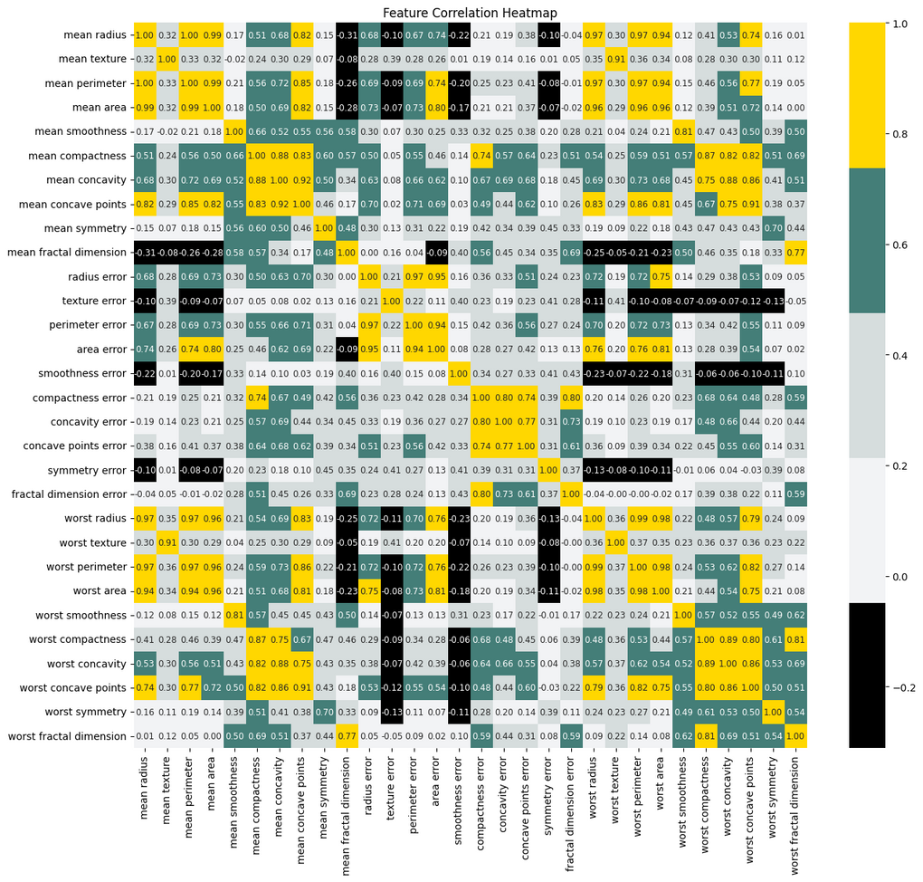
Exploratory Data Analysis (EDA)
Feature Correlation Heatmap
High Correlation in Tumor Size-Related Feature:
Mean radius, perimeter, and area show a very strong correlation (~0.99), as do their "worst" counterparts, indicating redundancy in these features.
Concavity & Concave Points as Key Indicators:
Mean concave points and mean concavity are highly correlated (~0.86), which suggests that tumors with more concave indentations on their surface are likely to be malignant.
Lower Correlation for Smoothness & Symmetry
Features like smoothness and symmetry show weaker correlations, meaning they provide independent diagnostic value beyond tumor size.

Slide 11
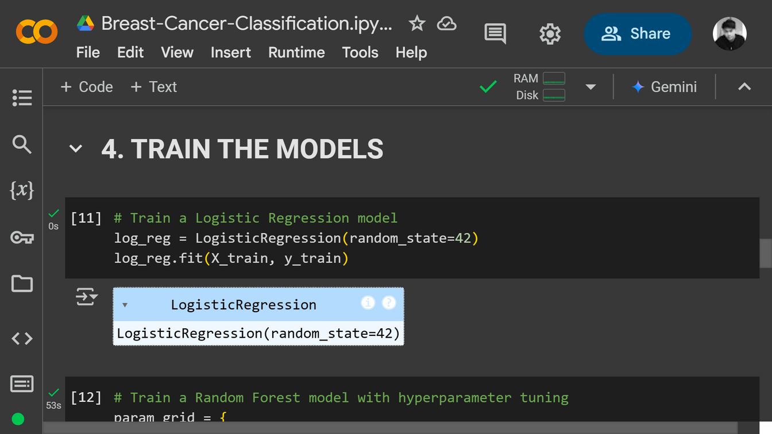
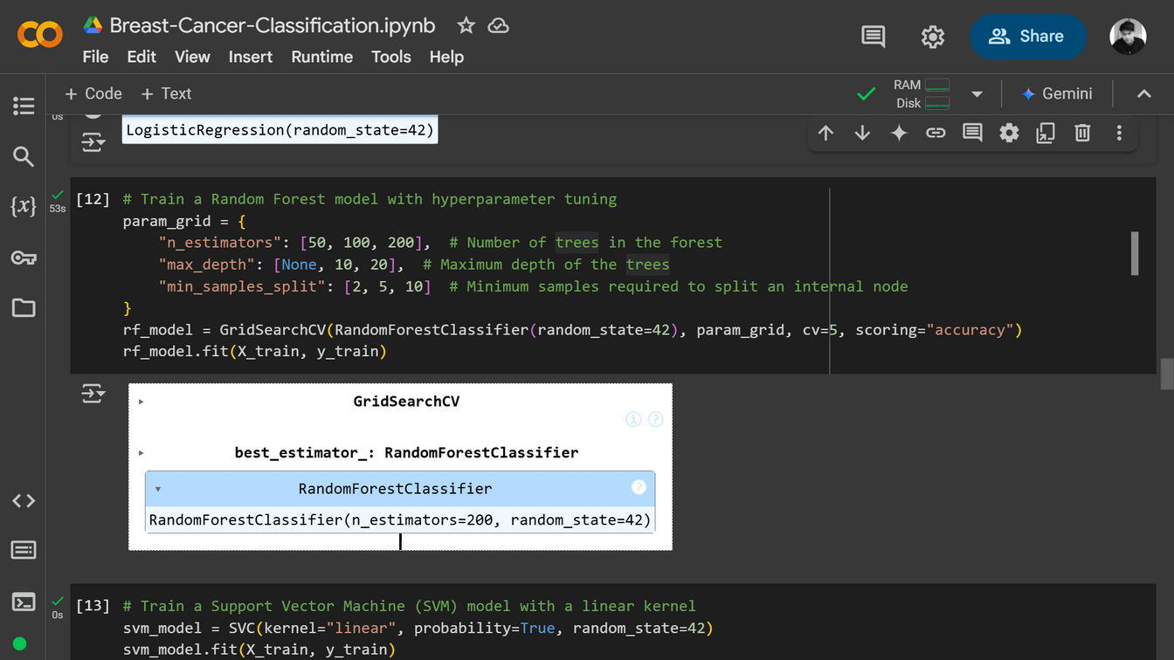
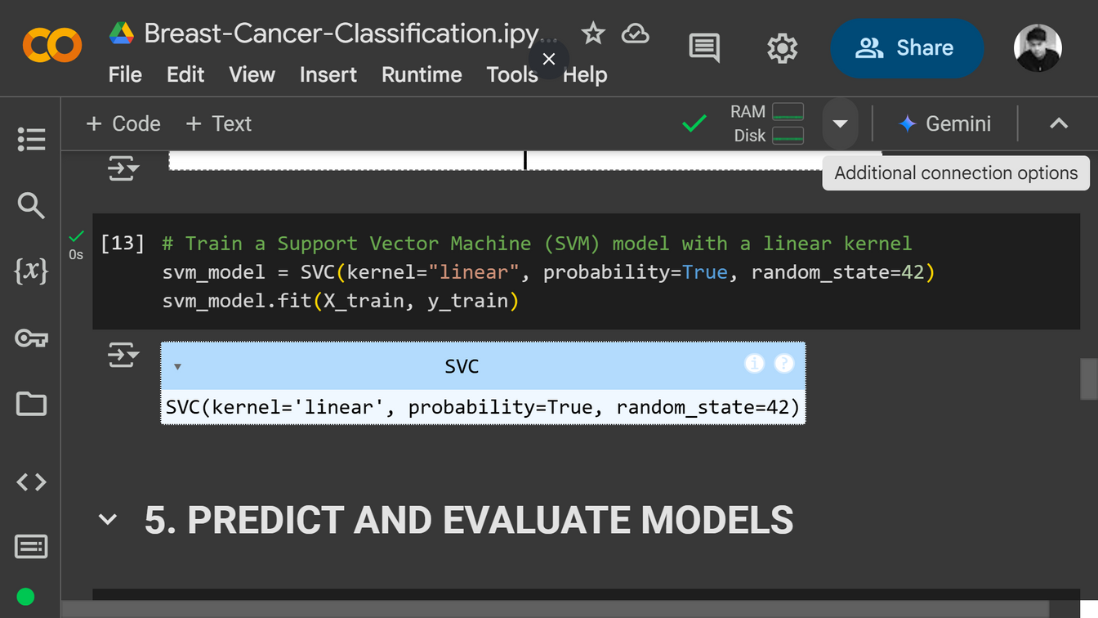
Train the Models
This section demonstrates the training of three machine learning models—Logistic Regression, Random Forest, and Support Vector Machine (SVM)—on the Breast Cancer dataset. Each model is trained to classify tumors as either Malignant (0) or Benign (1) based on the provided features.
Machine Learning Algorithms

Slide 12
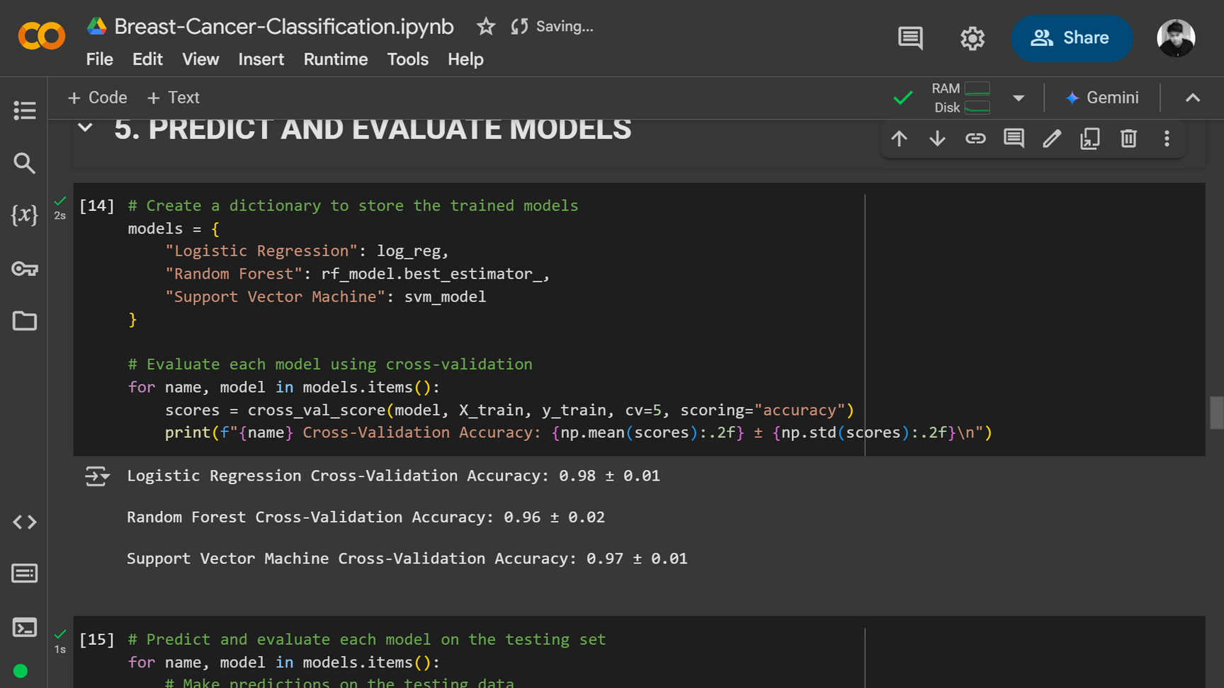
Predict and Evaluate Models
Cross-Validation
This section focuses on evaluating the performance of the trained models using cross-validation. The goal is to assess the model’s generalization ability and consistency across different subsets of the data.
Results:
Logistic Regression: 0.98 ± 0.01
Random Forest: 0.96 ± 0.02
SVM: 0.97 ± 0.01
All models show high and consistent accuracy, with Logistic Regression having the highest average accuracy and lowest standard deviation

Slide 13
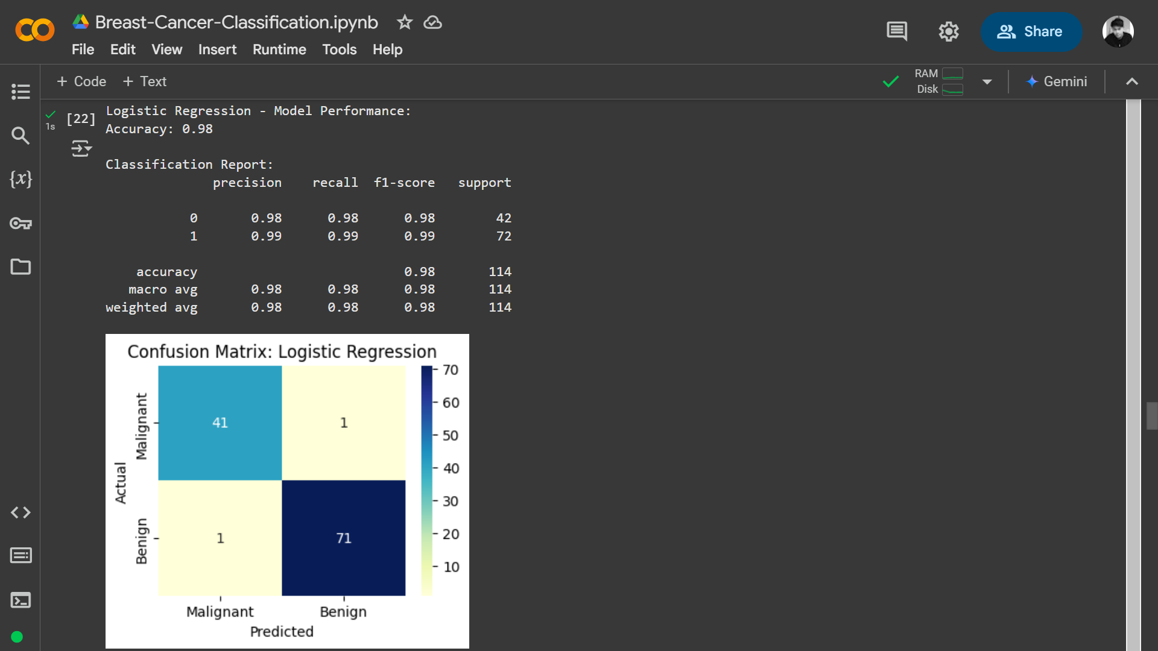
Predict and Evaluate Models
Logistic Regression Model Performance
The Logistic Regression model demonstrates high precision and recall for both classes, indicating strong performance in distinguishing between Malignant and Benign tumors.
The F1-score of 0.98 for Malignant and 0.99 for Benign highlights the model's balanced performance.
The confusion matrix shows that the model makes very few errors, with most predictions aligning with the actual labels.
The evaluation includes accuracy, a classification report, and a confusion matrix.
Logistic Regression achieves an accuracy of 0.98, indicating excellent performance.

Slide 14

Predict and Evaluate Models
Random Forest Model Performance
The Random Forest model demonstrates high precision and recall for both classes, indicating strong performance in distinguishing between Malignant and Benign tumors.
The F1-score of 0.94 for Malignant and 0.97 for Benign highlights the model's balanced performance.
The confusion matrix shows that the model makes very few errors, with most predictions aligning with the actual labels.
The evaluation includes accuracy, a classification report, and a confusion matrix.
Random Forest achieves an accuracy of 0.96, indicating strong performance.

Slide 15
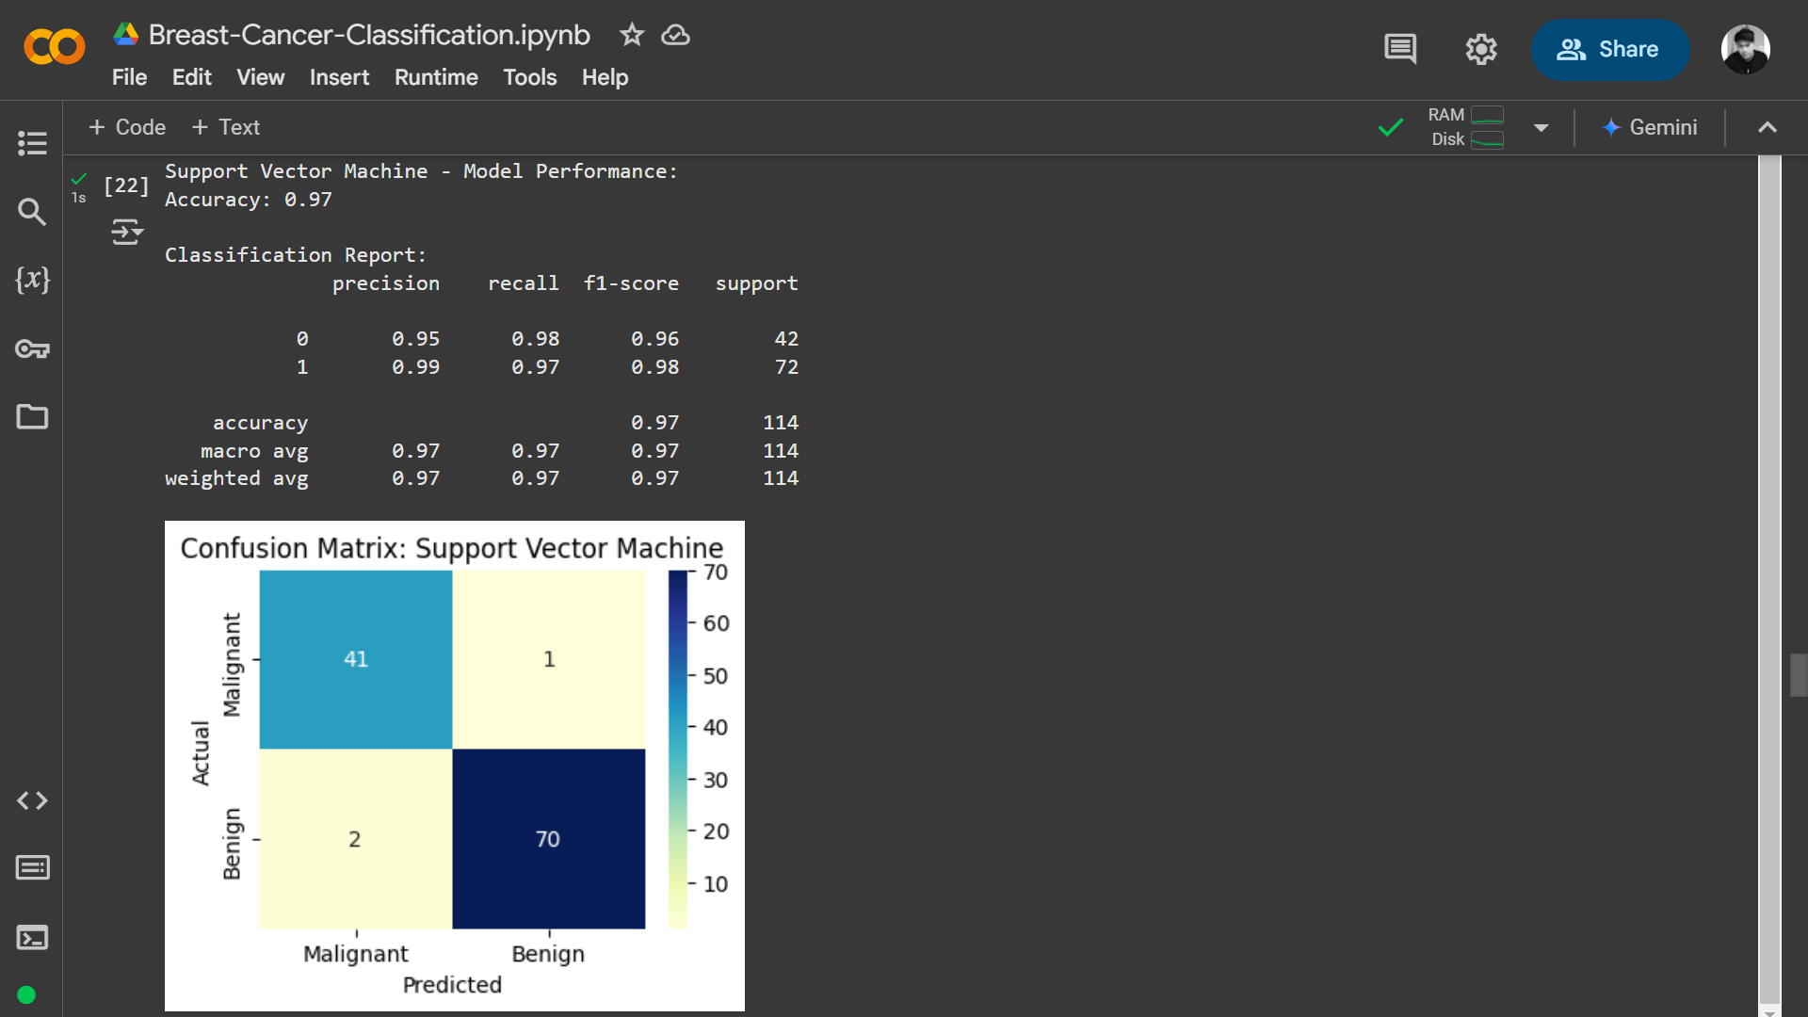
Predict and Evaluate Models
Support Vector Machine (SVM) Model Performance
The SVM model demonstrates high precision and recall for both classes, indicating strong performance in distinguishing between Malignant and Benign tumors.
The F1-score of 0.96 for Malignant and 0.98 for Benign highlights the model's balanced performance.
The confusion matrix shows that the model makes very few errors, with most predictions aligning with the actual labels.
The evaluation includes accuracy, a classification report, and a confusion matrix.
SVM achieves an accuracy of 0.97, indicating excellent performance.

Slide 16
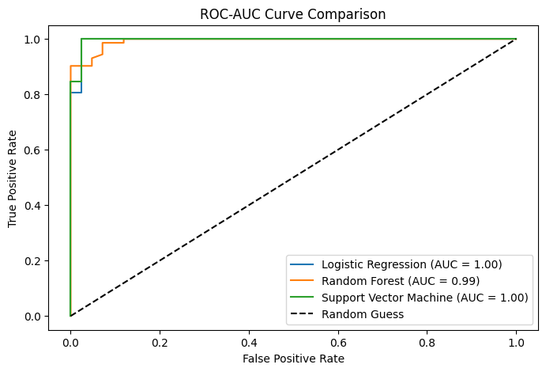
Predict and Evaluate Models
ROC-AUC Curve Comparison for Model Performance Evaluation
The ROC curve shows the trade-off between the True Positive Rate (TPR) and False Positive Rate (FPR).
The AUC score measures model performance, where 1.00 indicates perfect classification and 0.5 represents random guessing.
The dashed diagonal line represents a random guess baseline, which serves as a comparison for model performance.
These results indicate that all models perform exceptionally well, with Logistic Regression and SVM achieving perfect AUC scores.

Slide 17
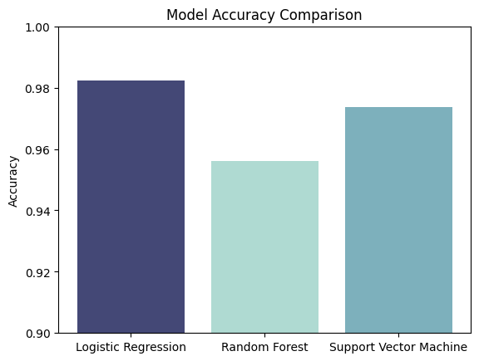
Predict and Evaluate Models
Model Accuracy Comparison:
Logistic Regression, Random Forest, and SVM
The accuracy comparison highlights the strong performance of all three models, with Logistic Regression emerging as the top performer.
These results demonstrate the potential of machine learning in accurately classifying breast cancer tumors, paving the way for real-world applications in medical diagnosis.

Slide 18
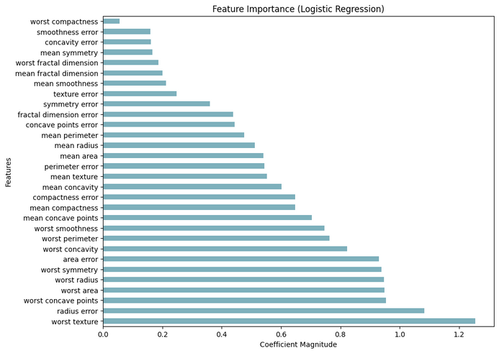
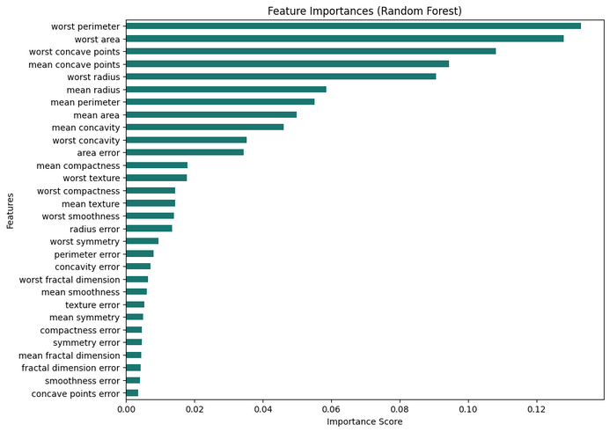
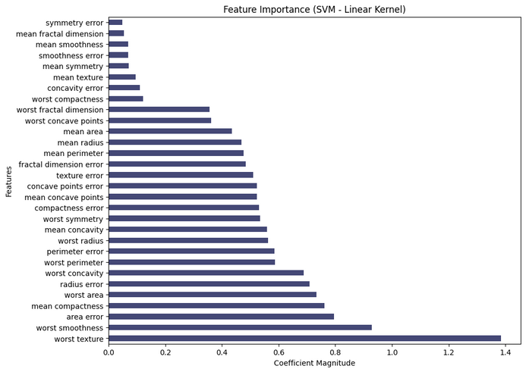
Data Visualization
Feature Importance Across Models:
Logistic Regression, Random Forest, and SVM
This section visualizes the feature importance for three machine learning models—Logistic Regression, Random Forest, and Support Vector Machine (SVM). Feature importance helps identify which features contribute the most to the model's predictions, providing insights into the key factors that influence the classification of breast cancer tumors as Malignant (0) or Benign (1).
Logistic Regression:
Features like "worst texture", "radius error", and "worst concave points" have the highest coefficients, making them the most influential.
These features relate to tumor size, shape, and texture, which are crucial in distinguishing Malignant from Benign cases.
Random Forest:
"Worst perimeter", "worst area", and "worst concave points" rank highest in importance.
Feature importance is determined by how often a feature contributes to tree splits.
Support Vector Machine (SVM):
"Worst texture", "worst smoothness", and "area error" show the highest influence.
The model assigns importance through coefficient magnitudes, where larger values indicate stronger impact.

Slide 19
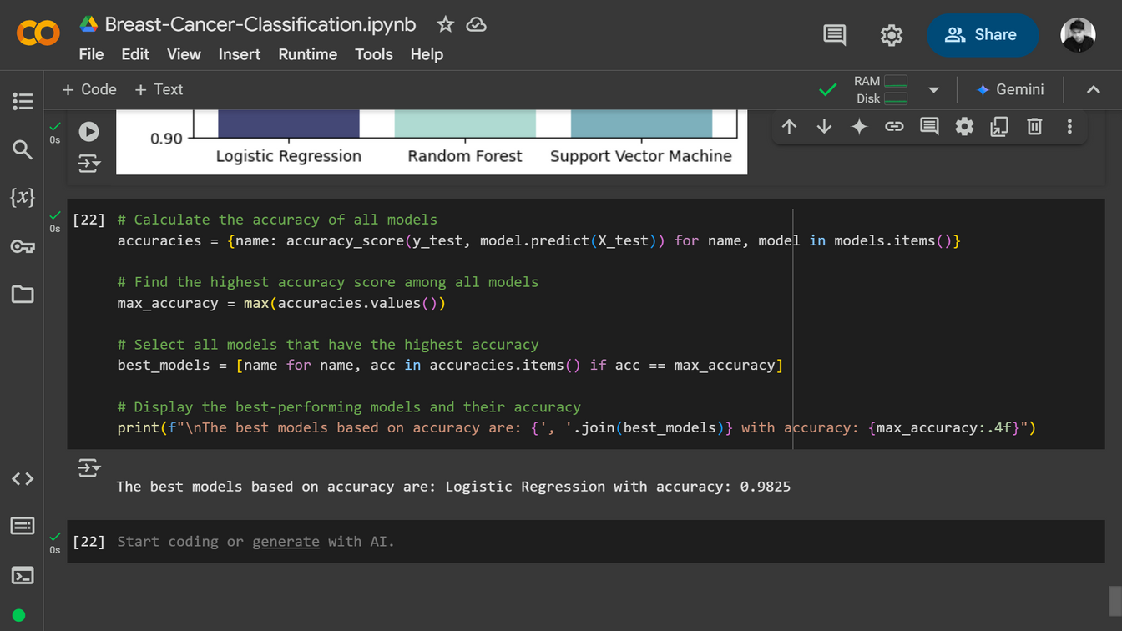
Conclusion
This project developed a machine learning-based classification model for breast cancer detection using the Breast Cancer Wisconsin Dataset. The objective was to analyze tumor characteristics and determine whether a tumor is Malignant (cancerous) or Benign (non-cancerous) with high accuracy.
To achieve this, we followed a structured machine learning pipeline, including:
Data Preprocessing to scale features and prepare the dataset for modeling.
Exploratory Data Analysis (EDA) to understand feature distributions and correlations.
Training multiple machine learning models to compare their performance.
Model evaluation using various performance metrics to identify the most reliable classifier.
The Logistic Regression model emerges as the best-performing model with an accuracy of 98.25%, demonstrating its reliability and effectiveness in classifying breast cancer tumors.

Slide 20





Thank You
It means a lot that you took the time to explore this presentation.
I hope it was insightful, and I welcome any questions or discussions!
@deviadns
linkedin.com/in/deviandinisastro
deviadns1@gmail.com
github.com/deviandinisastro

